Slide 1
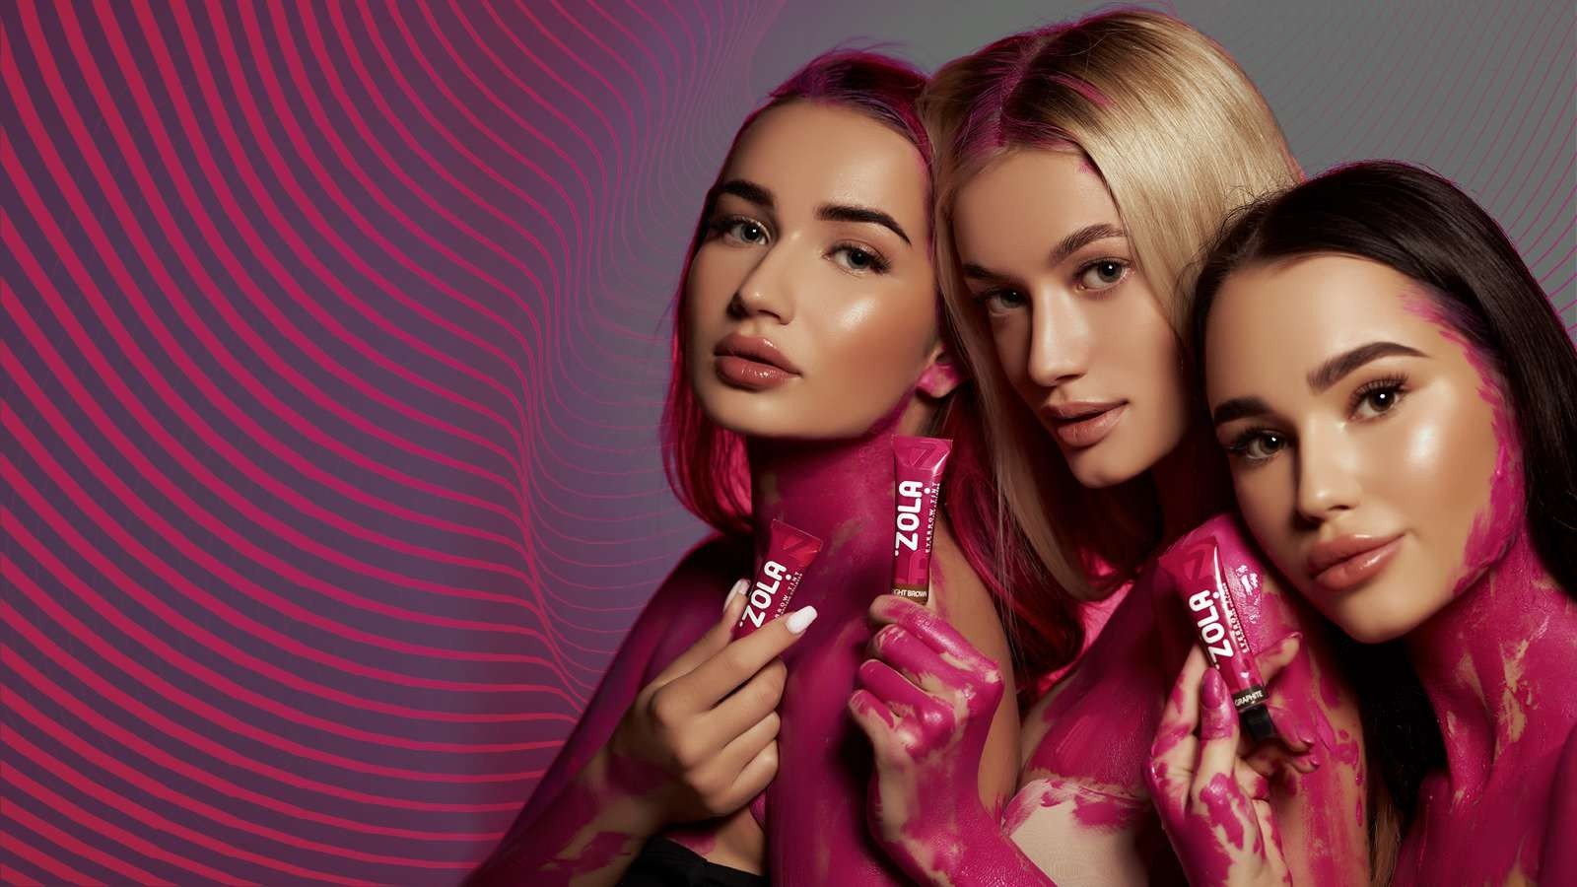

Slide 2




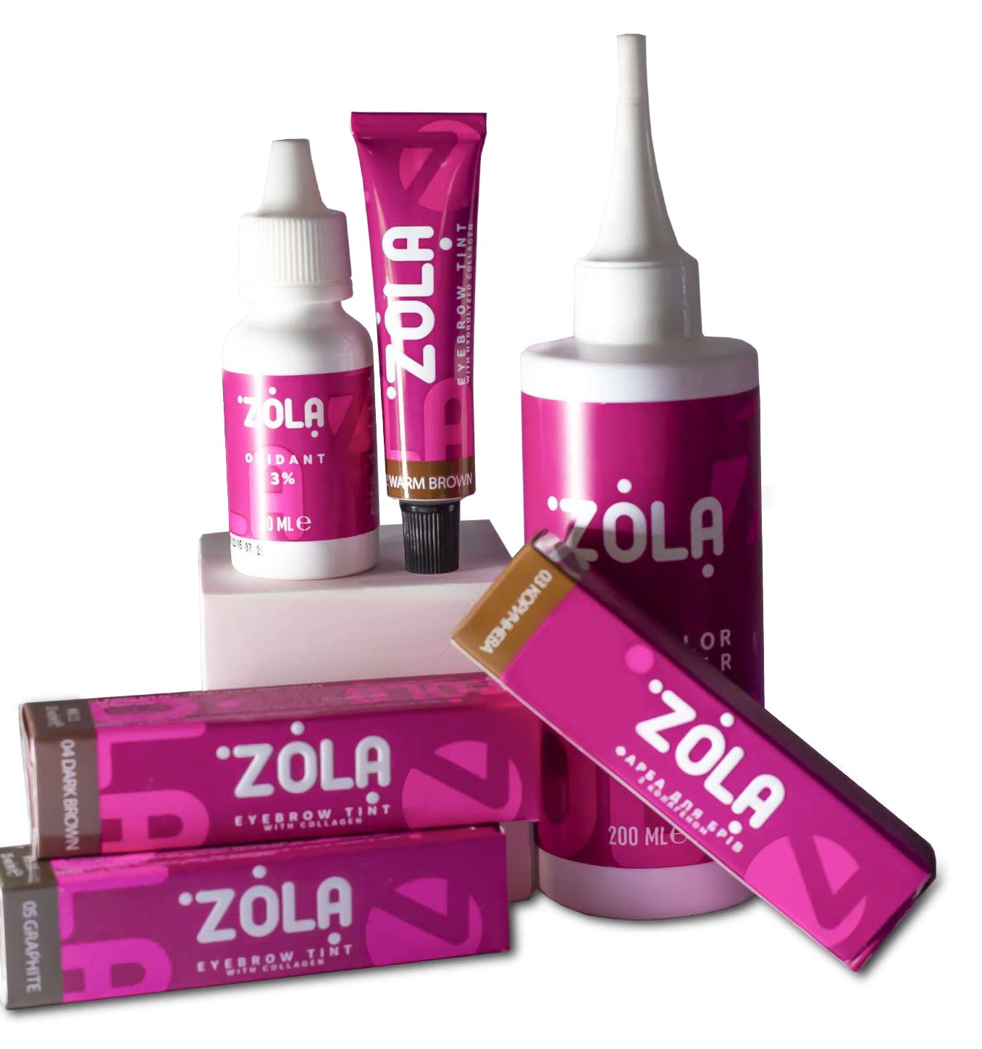


NEW GENERATION DYE
Dye is a new word
in the world of eyebrow dyes
Demi-permanent dye is gentle due to the new gen- eration of mild lye DMAMP ULTRA PC, which gives bright, juicy coloring on hair and skin due to the in- creased amount of dyeing agents.

Slide 3

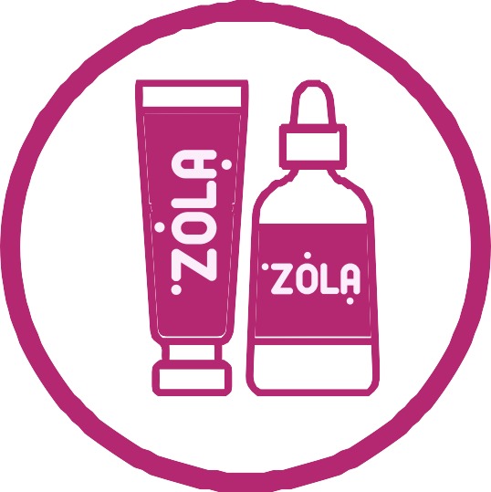
BENEFITS
Zola paint has a rich colouristic range of 5 colours and a great care composition based on hydrolysed collagen.
Comfortable texture, immediately having
a reddish-brown colour.
You can see at a glance where you are applying the dye.
Handy, ergonomic 15 ml tube with excellent ratio price/ quality.
Rich colouring in 5 shades:
light brown, brown, dark brown, warm brown, graphite.
Beautifully versatile shades, you'll be able to ﬁnd a shade for every type of look.

Slide 4



BENEFITS
New generation gentle lye
DMAMP ULTRA PC
Incredibly rich care dye composition,
which includes hydrolysed collagen, lanolin and sorbitol.
The unique lamellar structure of the paint. The latest development in cosmetic chemistry, gives the texture of the paint to be as similar as possible to the skin and its layers. This is why, with Zola, it gives your skin v brant colour and eﬃciently delivers the
colouring substances and caring substances to the epidermis.

Slide 5
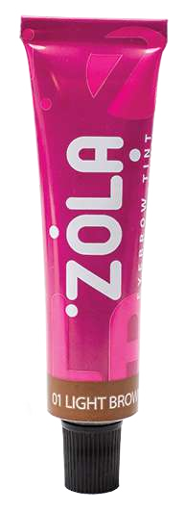
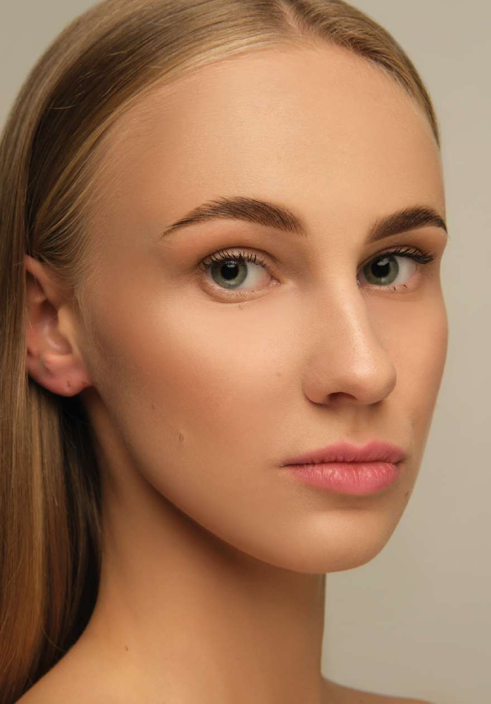
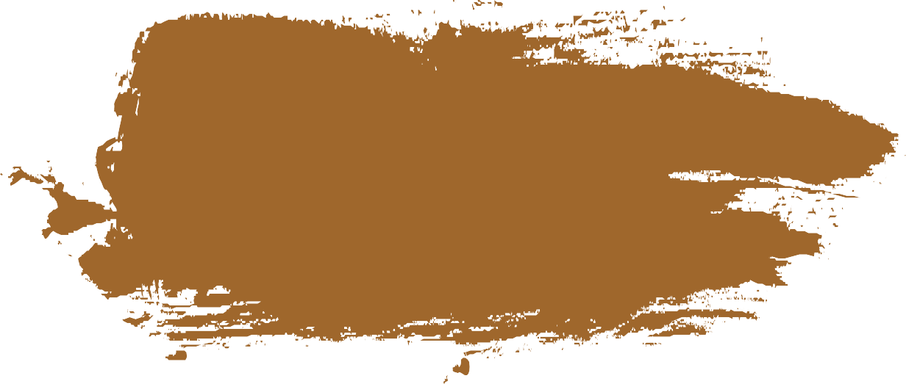
COLORISTICS
01 LIGHT BROWN
The universal shade for blondes and
fair-haired women, it doesn't darken the hairand has a unique colouring. On warm women, it lays down a warmer shade and on cooler women a cooler shade.

Slide 6
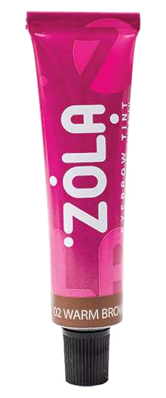
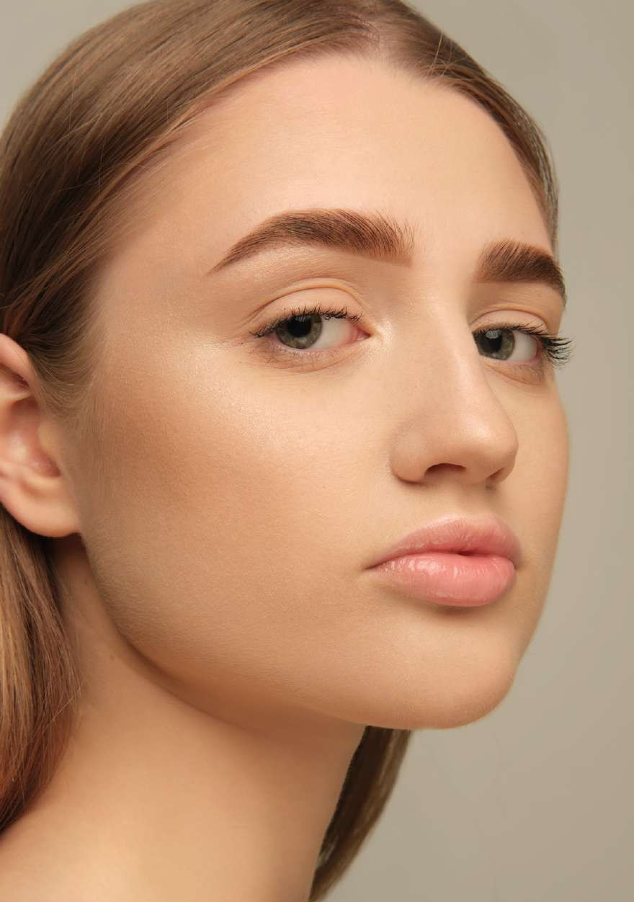
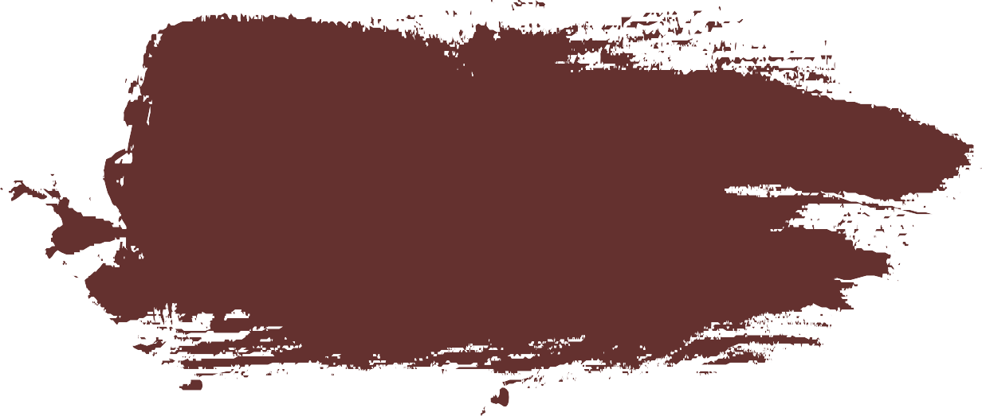
COLORISTICS
02 WARM BROWN
Ideal for redheads and warm brown hair, it has a rich copper-brown tone.

Slide 7
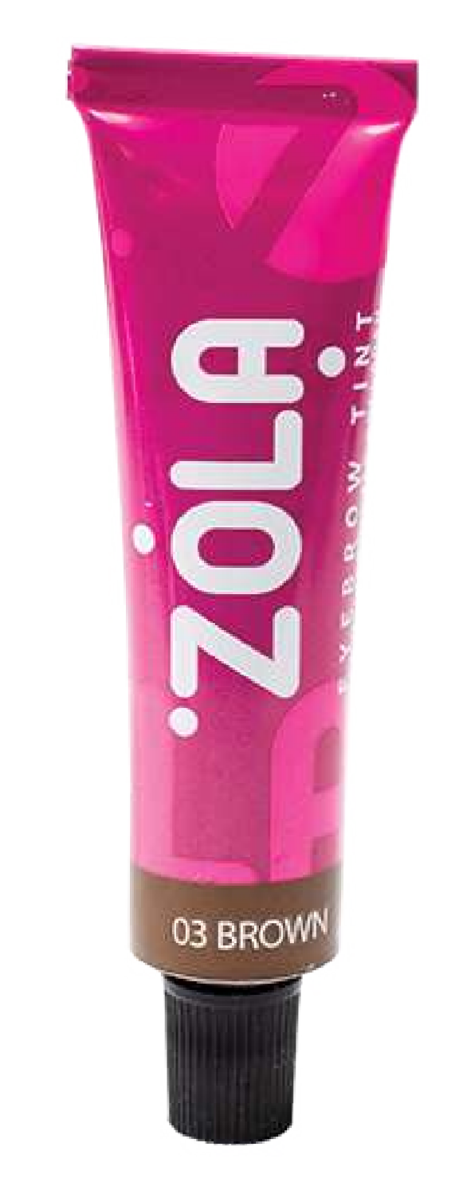
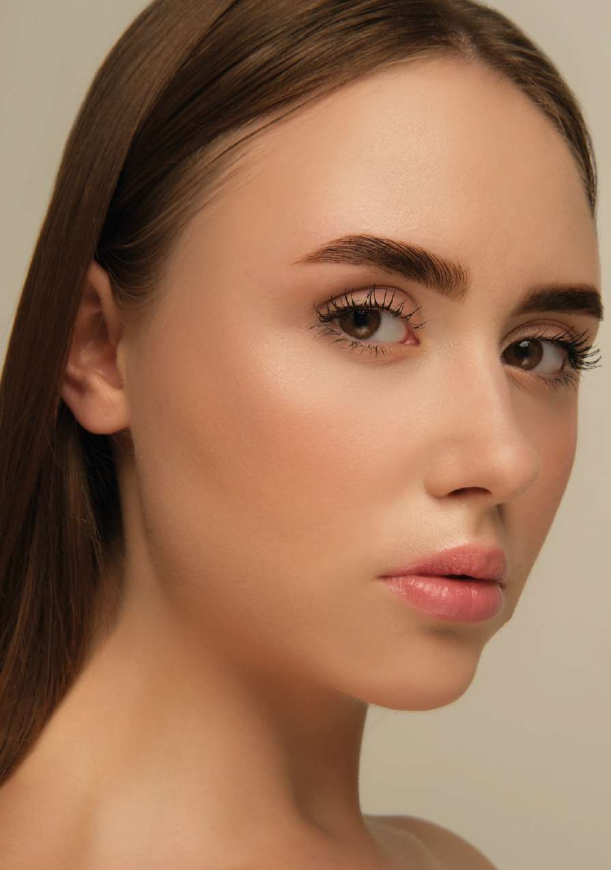
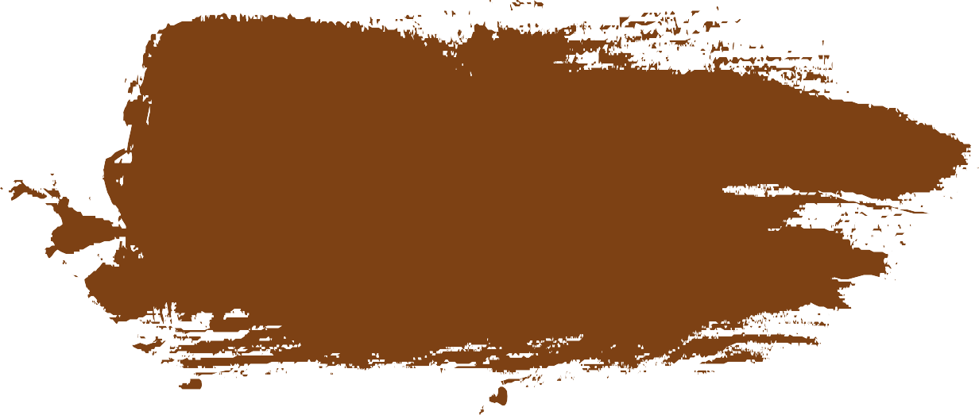
COLORISTICS
03 BROWN
A versatile brown shade, it takes on skin tightly and will suit anyone who wants a neutral shade of brown, from dark blonde to brown hair, brunetteto redhead.

Slide 8
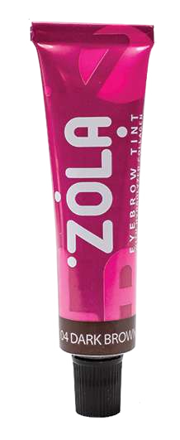
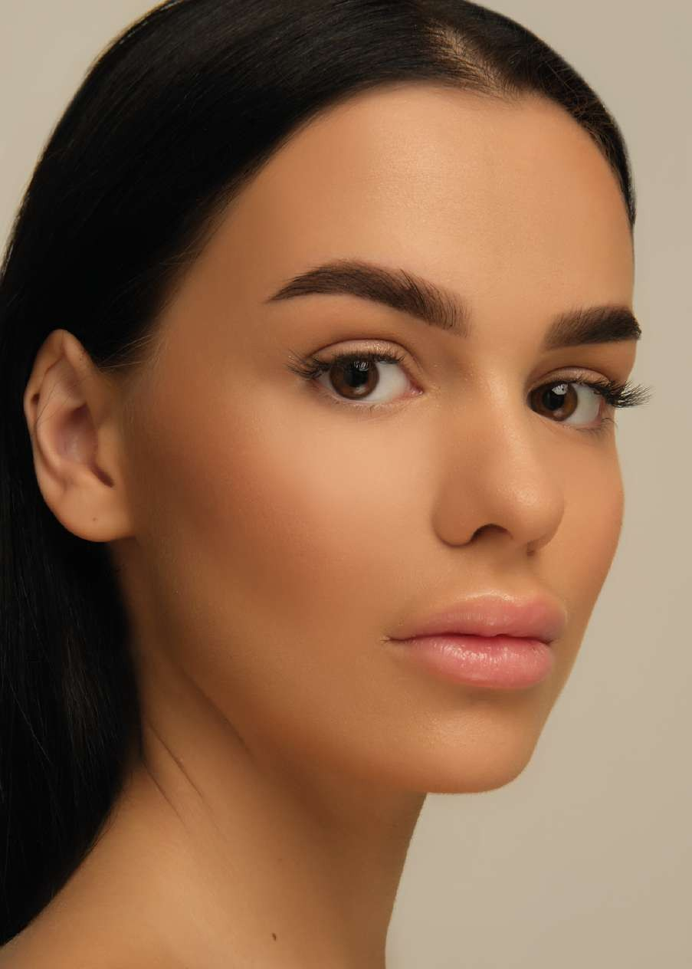
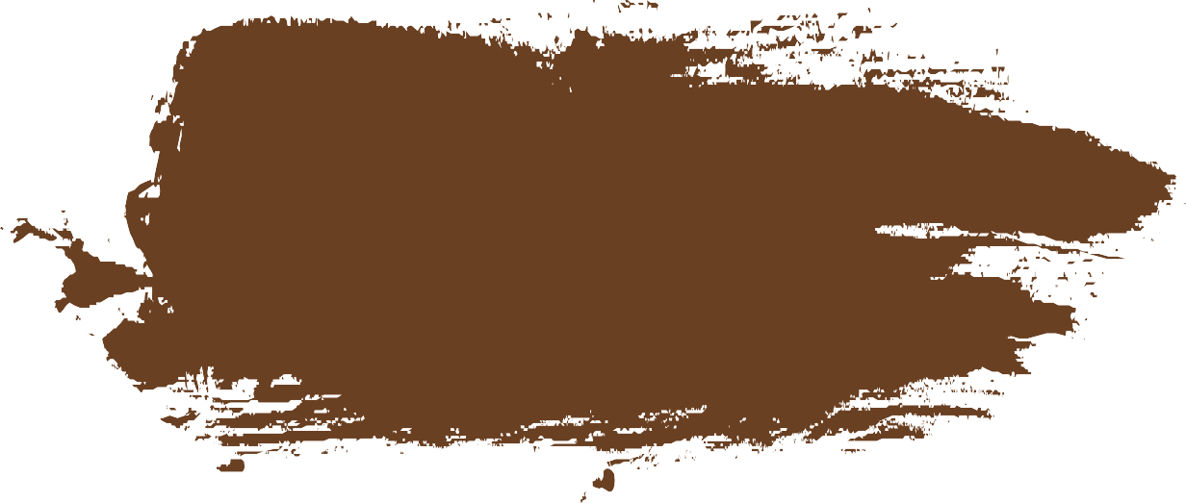
COLORISTICS
04 DARK BROWN
A neutral dark brown shade, it has a suitable neutral base for brunettes, brown hair and dark blondes.

Slide 9
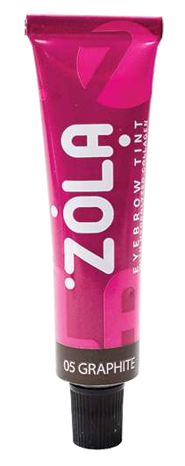
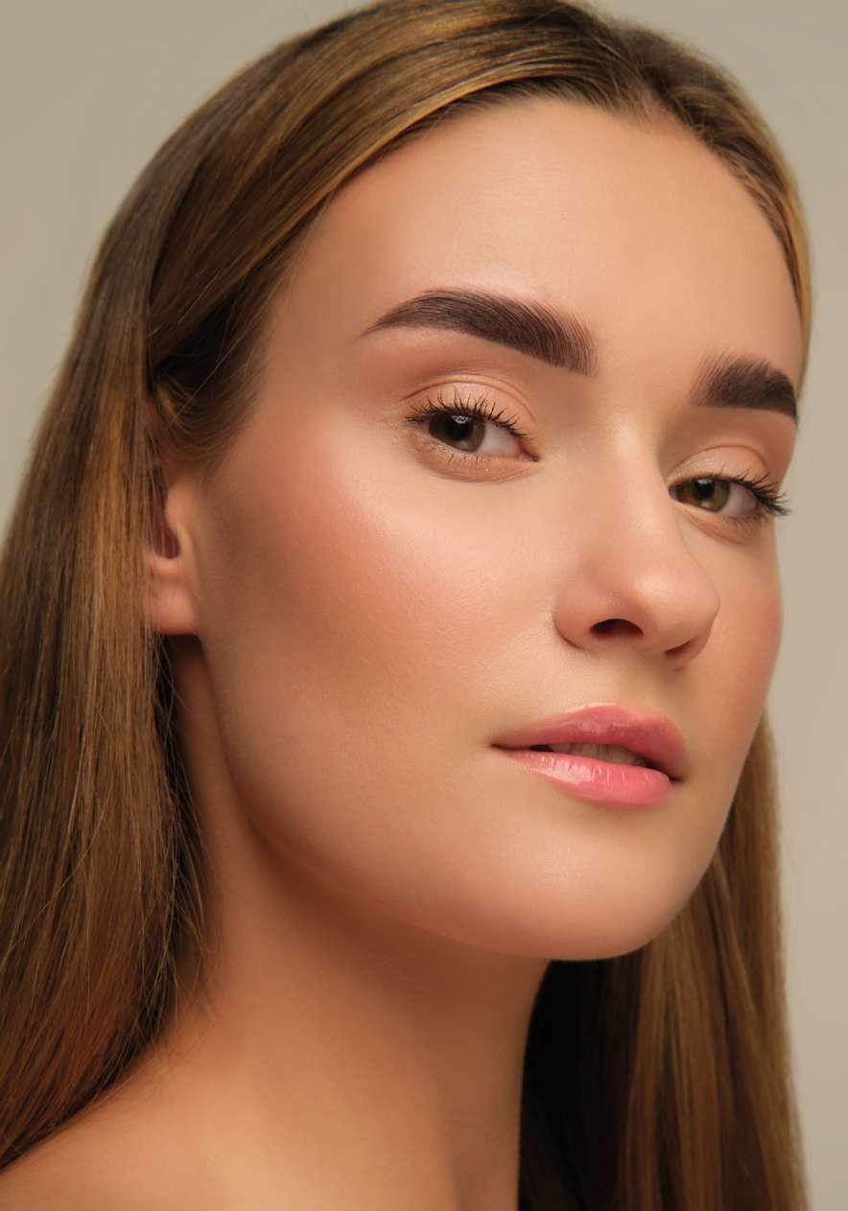
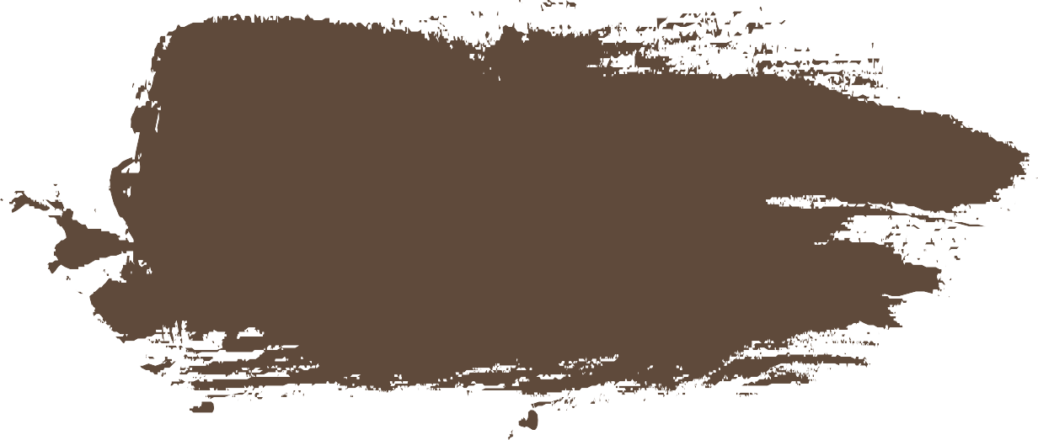
COLORISTICS
05 GRAPHITE
Cool graphite shade, can be used on its own or as a corrective colour. When added to brown, dark brown, light brown - you'll get more of the cooler shades.

Slide 10
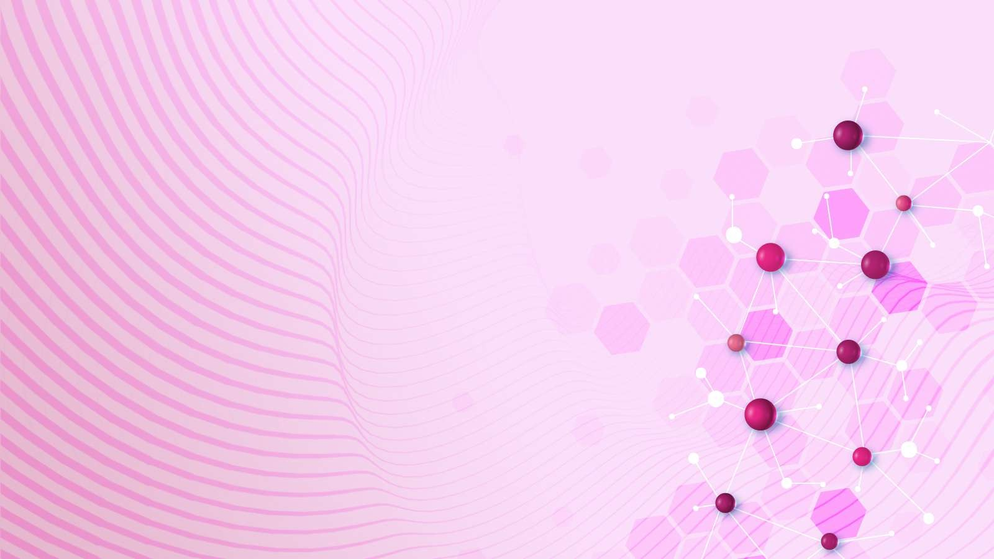
DMAMP ULTRA PC
Alkaline agent for oxidative hair dyes with excellent hold colour and improved washout resistance on bleached hair, especially for red and black shades.
The product also ensures eﬀective colouration of grey hair, retaining the colour even after 15 wash cycles.

Slide 11
LAMELLAR EMULSION
Lamellar emulsion - is similar in structure to the lipid layer of the skin,
with an aqueous layer in between.
It turns out that the layer closest to the skin is the water layer,
which contains the beneﬁcial substances
needed by the skin. This is followed
by an oil layer, which gives protection. The next layer is water-based and so on. The cream, like a 'patch', is perfectly incorporated into the epidermis,
heals injuries and restores its integrity.
That is, due to this unique dye structure, you get vibrant colouring on the skin and care properties.

Slide 12
HYDROLYZED COLLAGEN
This is a type of collagen that has undergone enzymatic hydrolysis, which involves using water to break down large amino acid chains on short chains. It imparts shine, manageability and elasticity to the hair.
Hydrolysed collagen is able to penetrate hair, increasing the strength of
the hair and its ﬂexibility, improving texture and reducing porosity.

Slide 13
LANOLIN
Animal wax derived from the treatment
of sheep's hair.
The main purpose of lanolin is to protect and condition the skin, and it normalises the lipid balance on the sur- face of the skin, which helps to reduce the loss
of moisture and, consequently, ensures that the skin is soft
The useful qualities of lanolin include the ability to heal wounds, regenerate, moisturise, nourish dehydrated skin, provides nourishment and moisturise
damaged hair.

Slide 14
SORBITOL
An organic compound, a six-atom alcohol, which is obtained by hydrogenation of glucose with reduction of the aldehyde group to the primary alcoholic group.
Sorbitol acts as an active moisturiser by trapping water on the surface of the skin, thus helping the skin to retain its own moisture, reducing its loss.
In combination with other moisturising ingredients in the paint, its moisturising properties are enhanced.

Slide 15
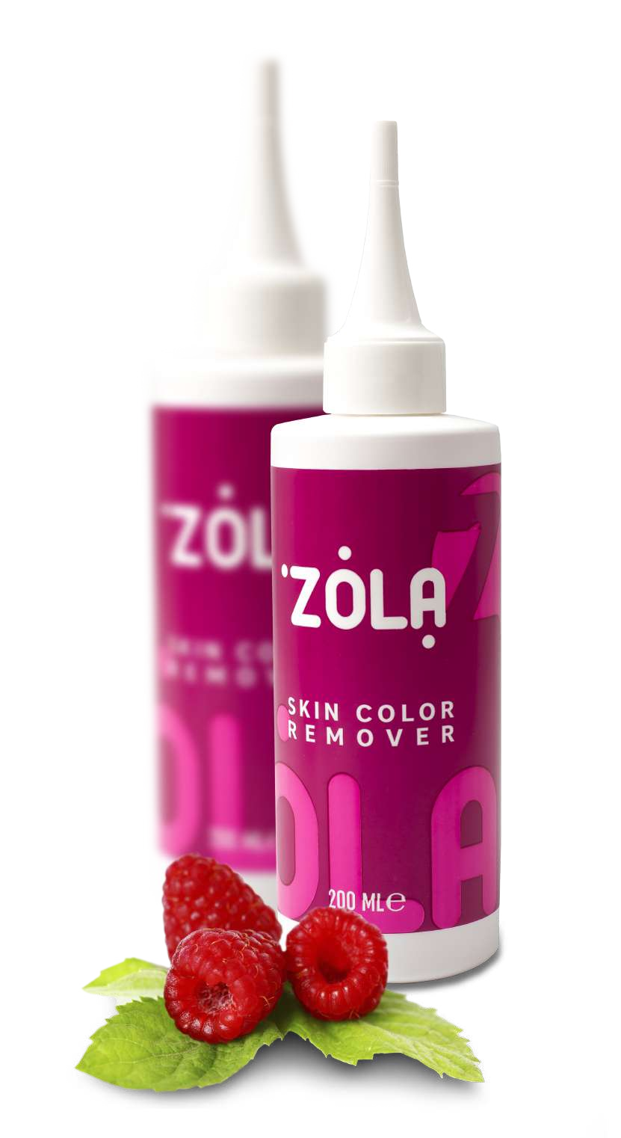
ZOLA REMOVER
The product is designed to remove
paint residue from the skin after colouring.
The consistency allows you to control the ﬂow of the product and remove even the smallest nuances. Thanks to
its special raspberry ketonebased formula, it gently cleanses the surface of
the skin without drying it out.
Raspberry ketone has an overall strengthening eﬀect, stimulates hair
growth and prevents signs of early hair loss.

Slide 16
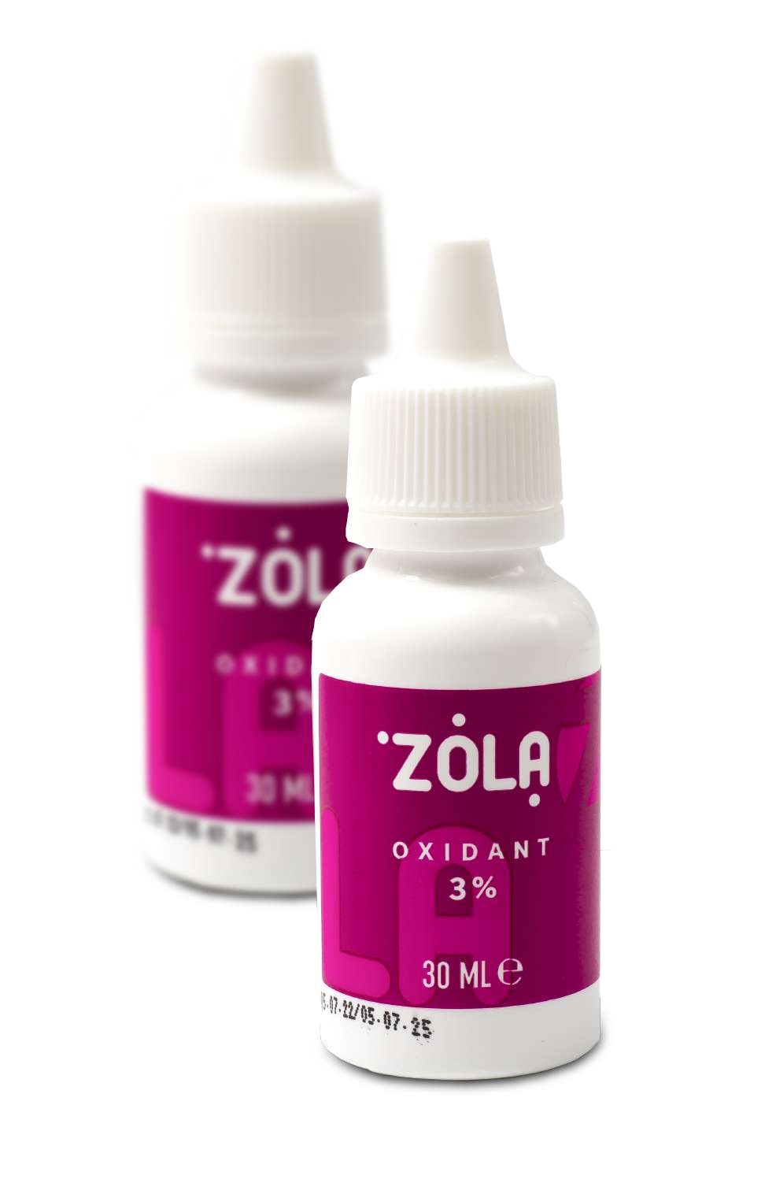
ZOLA OXIDANT 3%
The oxidant composition has been
speciﬁcally formulated for ZOLA dye,
we recommend using them in tandem to
achieve ﬂawless colour results and long-lasting effects.
Contains 3% hydrogen peroxide for maximum colour saturation and brightness, but is gentle on the hair without
damaging the structure of the hair. The advantage of the creamy consistency is that it is economical and easy to use by the brow artist.

Slide 17
